Slide 1
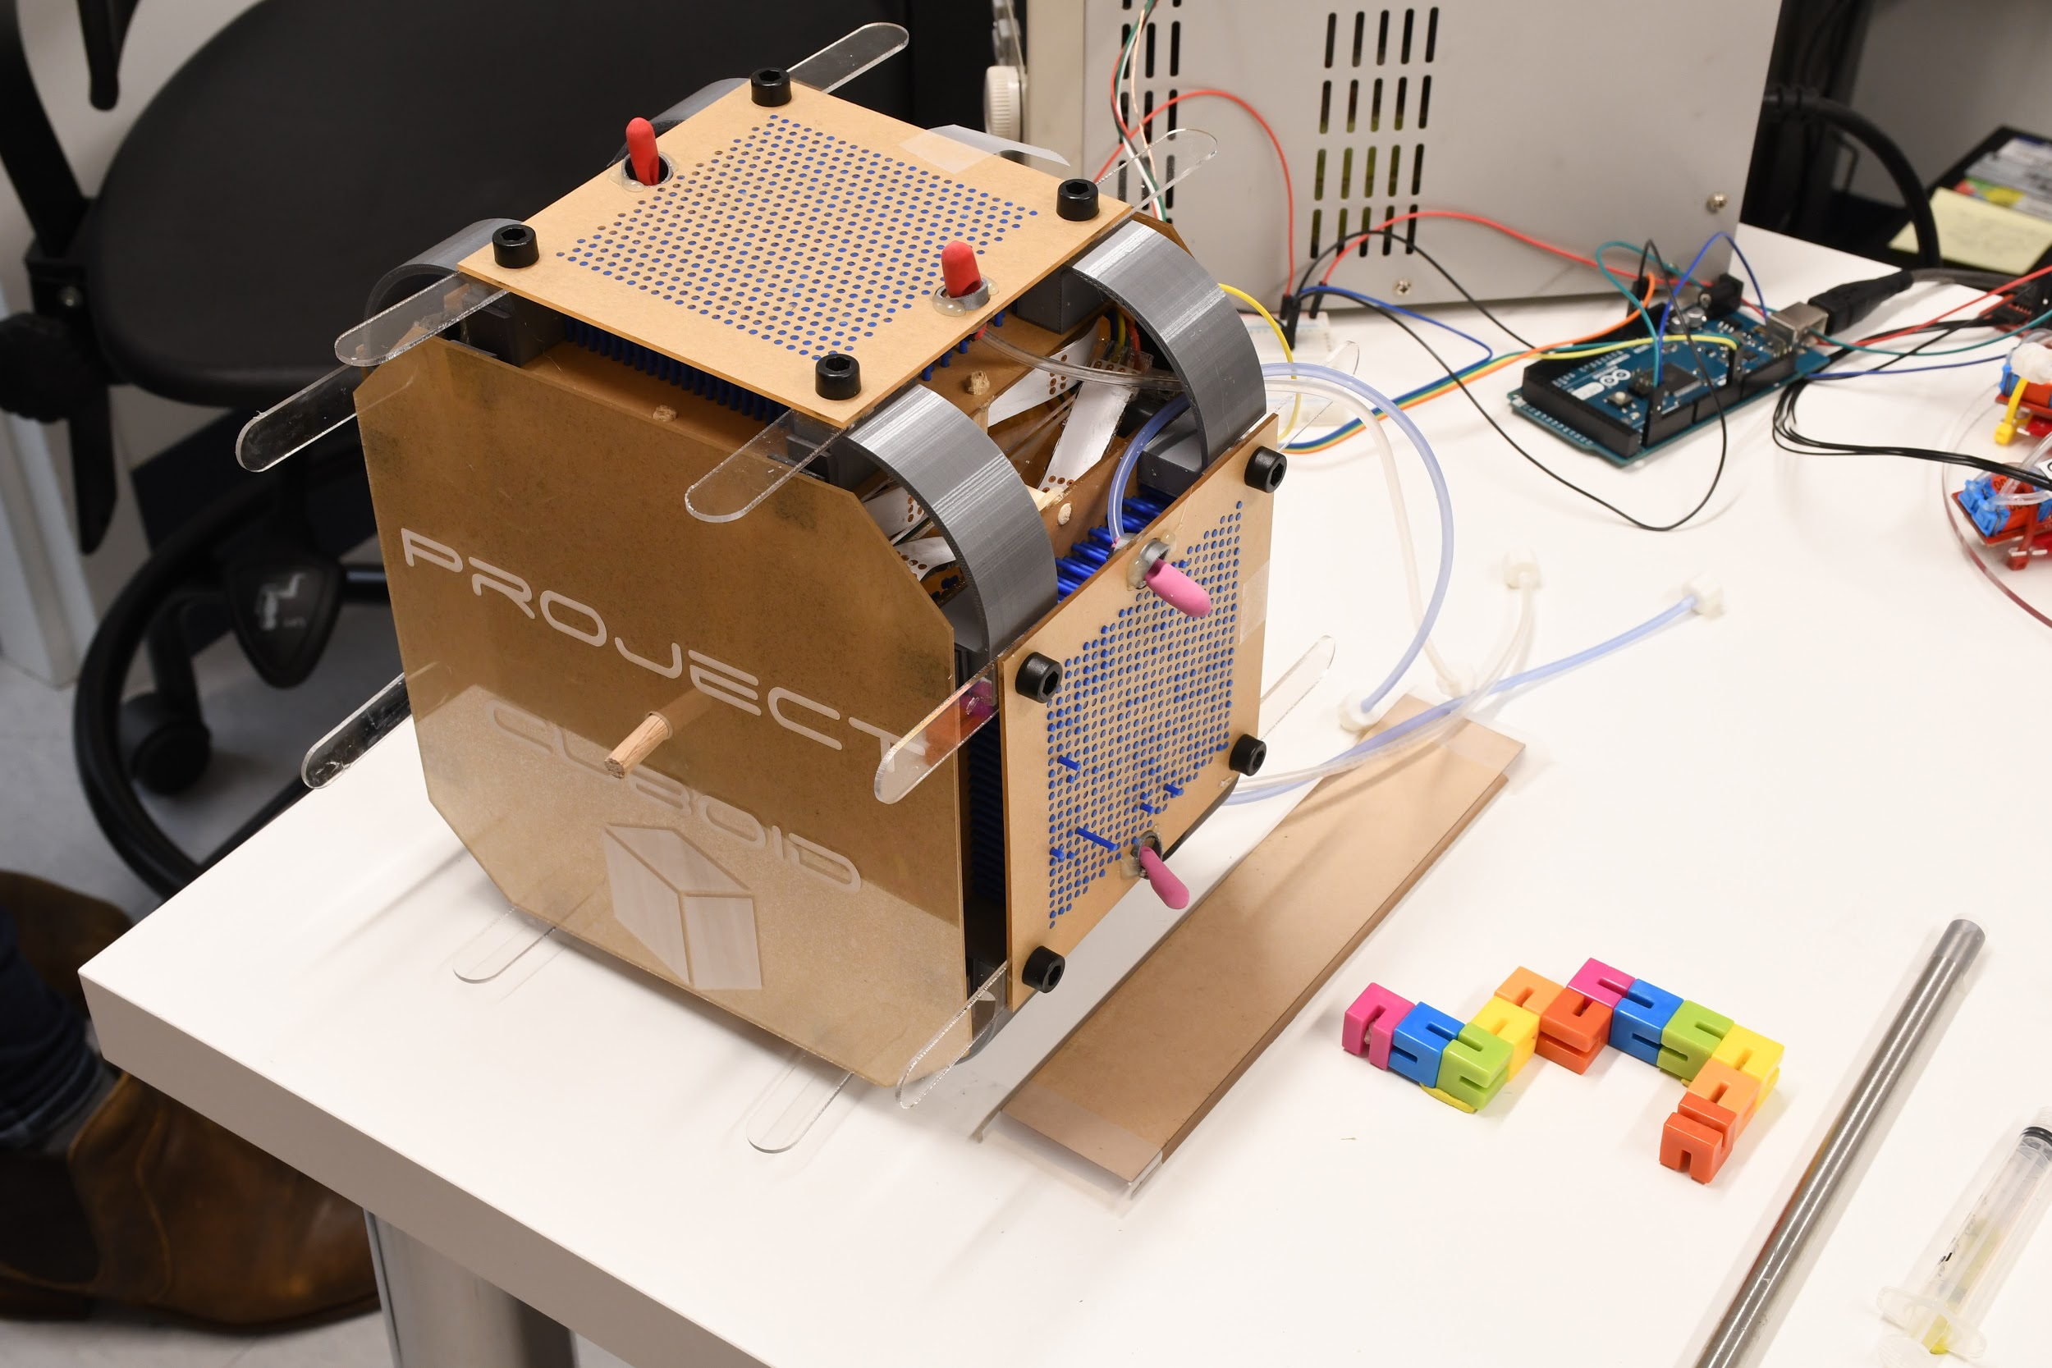
Project Cuboid
Robert Baines
Hayley McClintock
Andrew Morgan
Final Presentation - 12/3

Slide 2
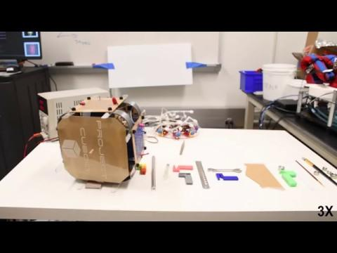

Slide 3
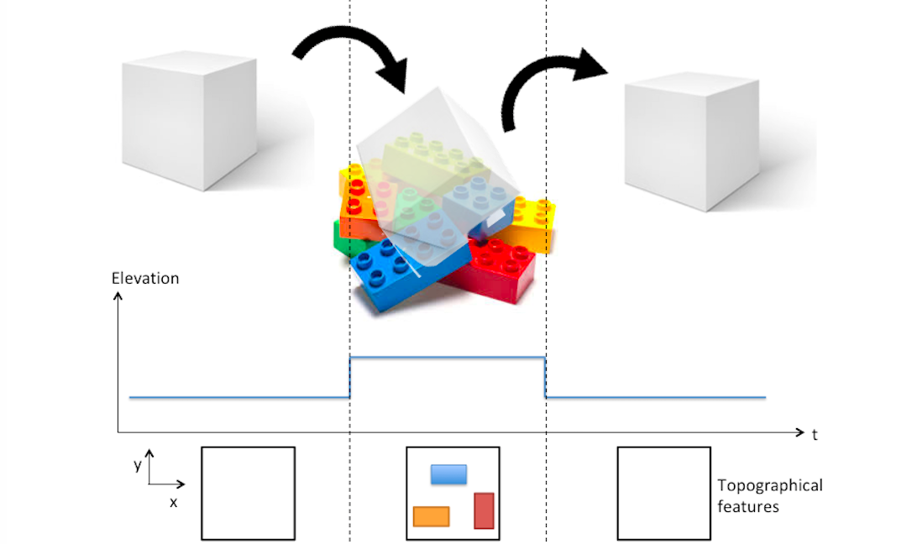
Problem Statement
A cuboid with a dynamic contact surface for adaptable motion and topographic mapping on variable terrains.

Slide 4

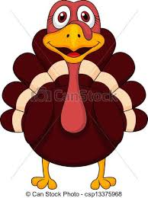
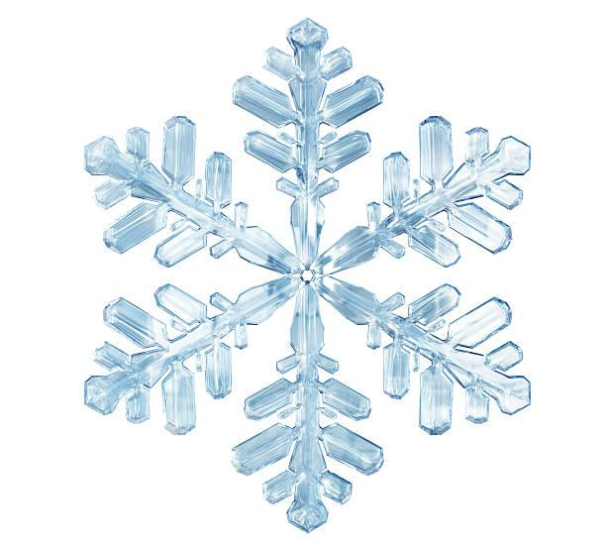
Deliverables
10/12
Order initial testing components
CAD model and design
Electronic architecture diagram
Complete solenoid testing
11/2
Prototype I constructed
Sensor calibration
Testing plan
12/3
Final cube finished
Achieve topographical mapping
Locomote over obstacle course

Slide 5
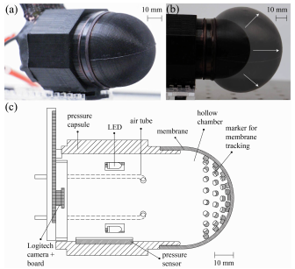
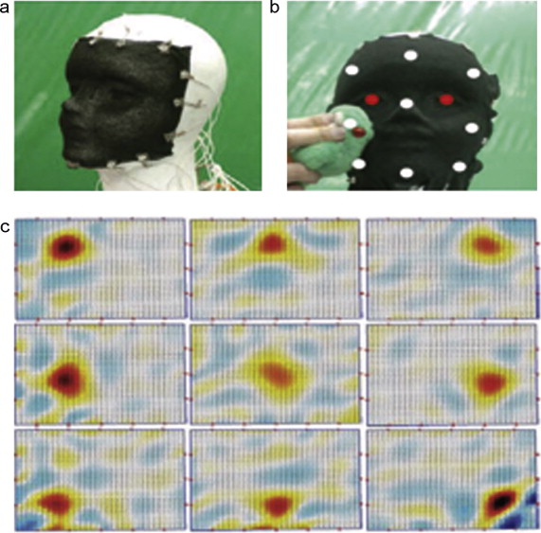
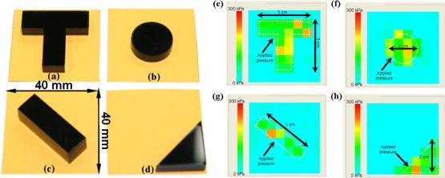
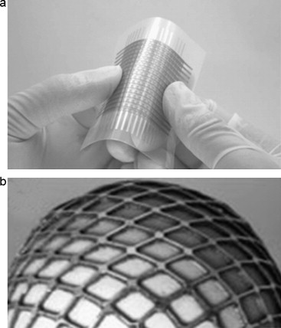
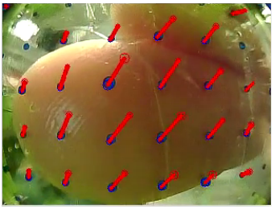
Lit review
Many methods for tactile sensing, but difficult to achieve high resolution or 3D reconstruction
Often employ expensive and complicated sensors
“Tactile sensing for dexterous in-hand manipulation in robotics—A review,” H. Yousef, et. al.
“Towards a Soft Fingertip with Integrated Sensing and Actuation,” B. McInroe, et. al.
“Optical Skin For Robots: Tactile Sensing And Whole-Body Vision,” A. Yamaguchi, et. al.

Slide 6
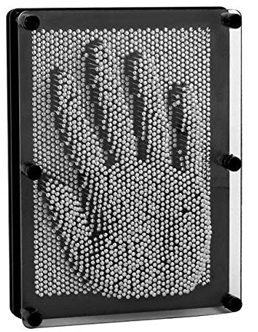
Lit review
Many methods for tactile sensing, but difficult to achieve high resolution or 3D reconstruction
Often employ expensive and complicated sensors
Our approach: draw inspiration from pin art toys to achieve a high resolution, conformable surface that can be translated into a topographical map

Slide 7
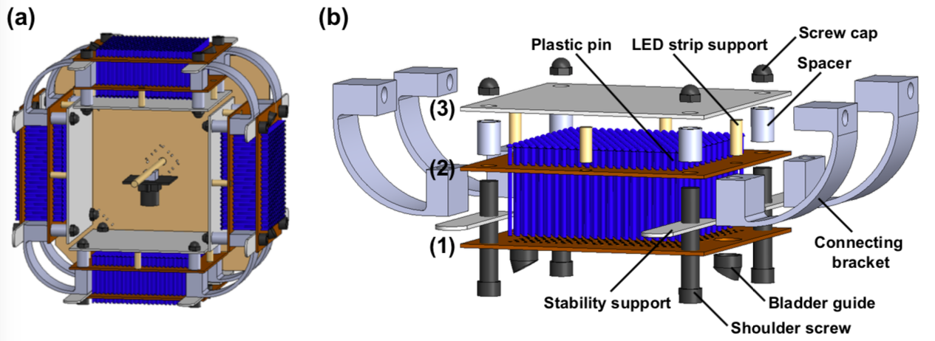
The cube

Slide 8
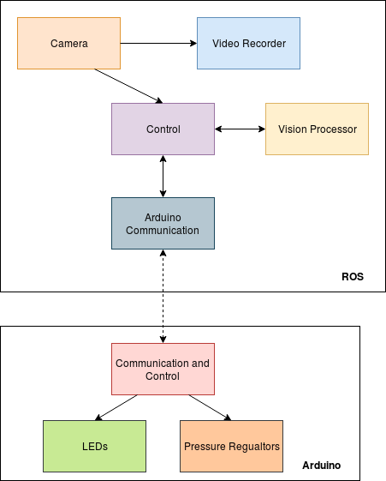
Software architecture
Comprised of ROS and Arduino Communication
ROS:
Camera publishes a raw image
Master control node in ROS schedules tasks and records data
Vision processor extracts HSV and segments image
Arduino communication opens a serial port for transfer of information
Arduino:
Communication and control reads in commands from ROS and turns On/Off LEDs and Pressure Regulators

Slide 9
Software architecture
Vision Processor:
Reads in raw image
Segments image in blocks of 40 rows and 50 columns
Computes average of each chunk
Gaussian filter with neighboring chunks
Find peaks and valleys of the data
Interpolate neighboring peaks to define geometries

Slide 10
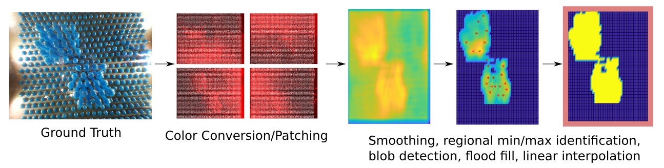
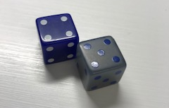
the mapping algorithm chain of processing
Notes:
First, cutting off extrama of image to decrase its size and cut off the not pin areas.

Slide 11
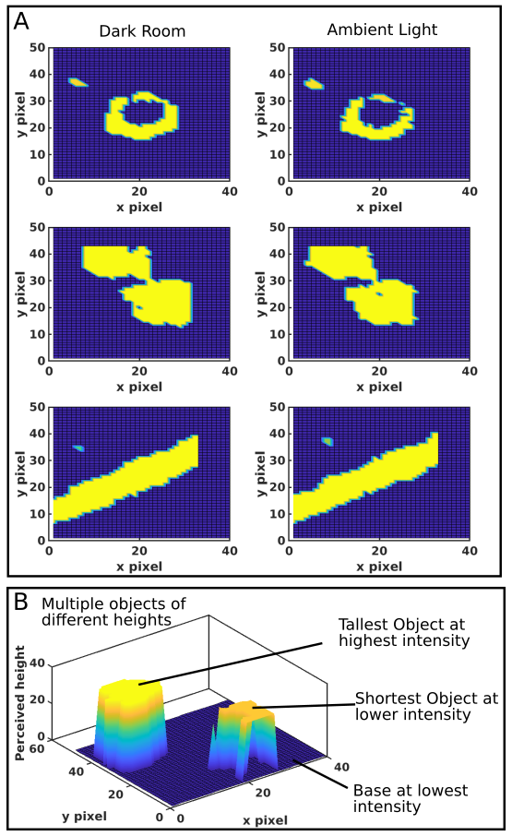
Evaluation: Light and Dark
Algorithm efficacy deteriorates in harsh room light
Dark room ~ Ambient Light
Ability to distinguish multiple heights impacted
Medium intensity LED light is optimal
Too bright LED light induces glare on pin toy cover

Slide 12
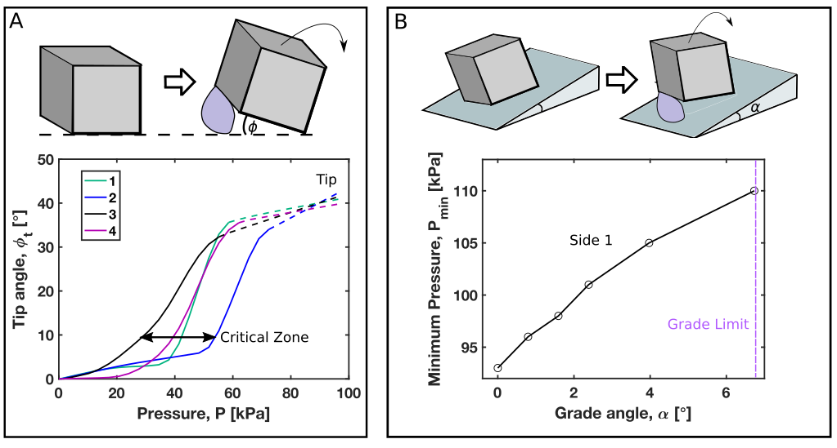
Evaluation: Tip and Ramp

Slide 13
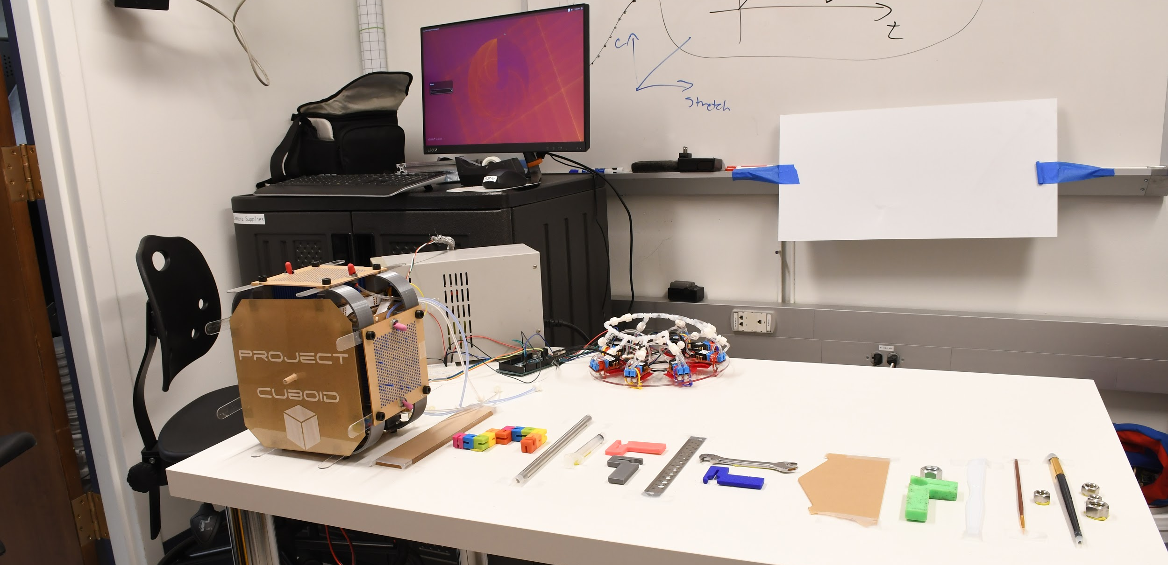
Evaluation: Obstacle Course

Slide 14
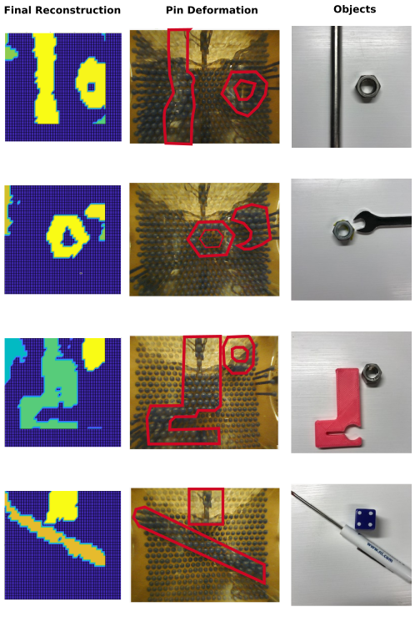
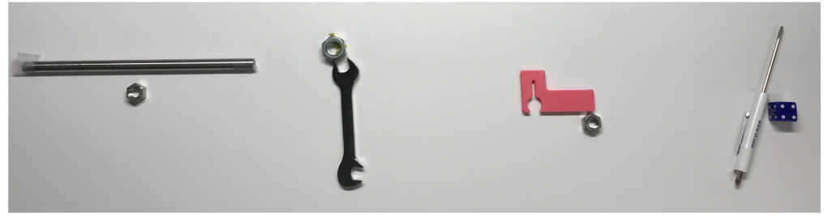
Simpler Obstacle Course
Variability of camera positioning
Wide angle distortion at extrema
Cube angle problem (higher object shifts)
Enhanced glare
Pins sticking
Pneumatic tubes getting stuck underneath
Overall decent reconstruction of course
Roll Direction
Notes:
Different color = percieved different height.
First face got heights right.
Second face did not (height of wrench really close to nut)
Third face did
Fourth face did
Also note that the algorithm is pretty good: pins are low resolution, so they loose inherently informatoin of object contours

Slide 15
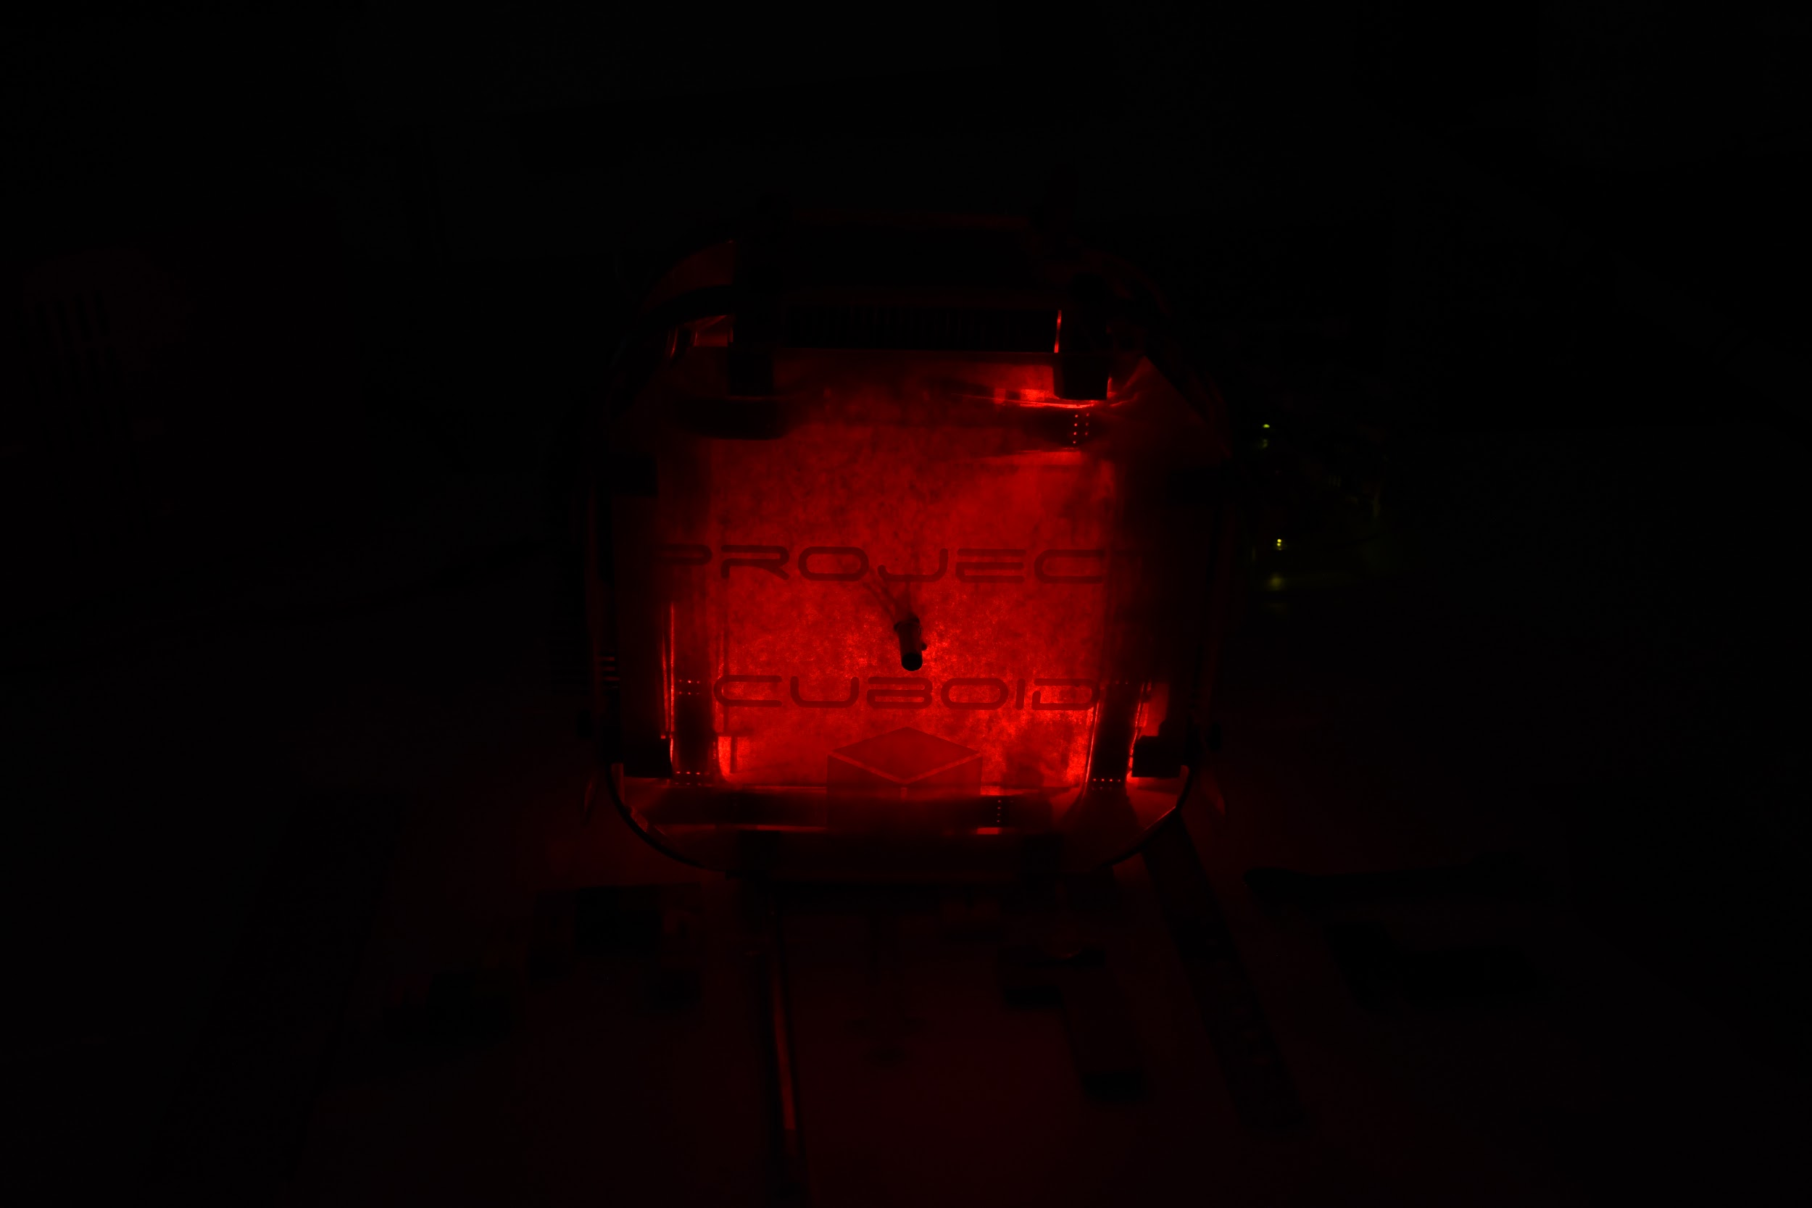
Future work
Integrate on-board IMU sensing and develop a control feedback loop
PID control of silicone bladders to optimize rolling
Improve passive mechanism of camera swivel, or integrate actuated swivel based on IMU sensing
Higher resolution pins
Algorithm robustness to variations in angle (from IMU feedback)
Contribute: github.com/asmorgan24/project_cuboid

Slide 16
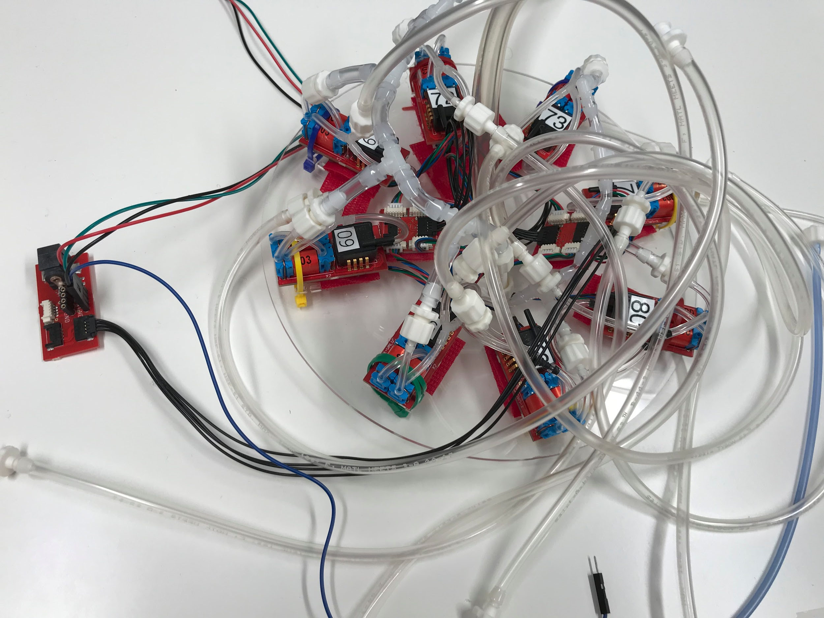

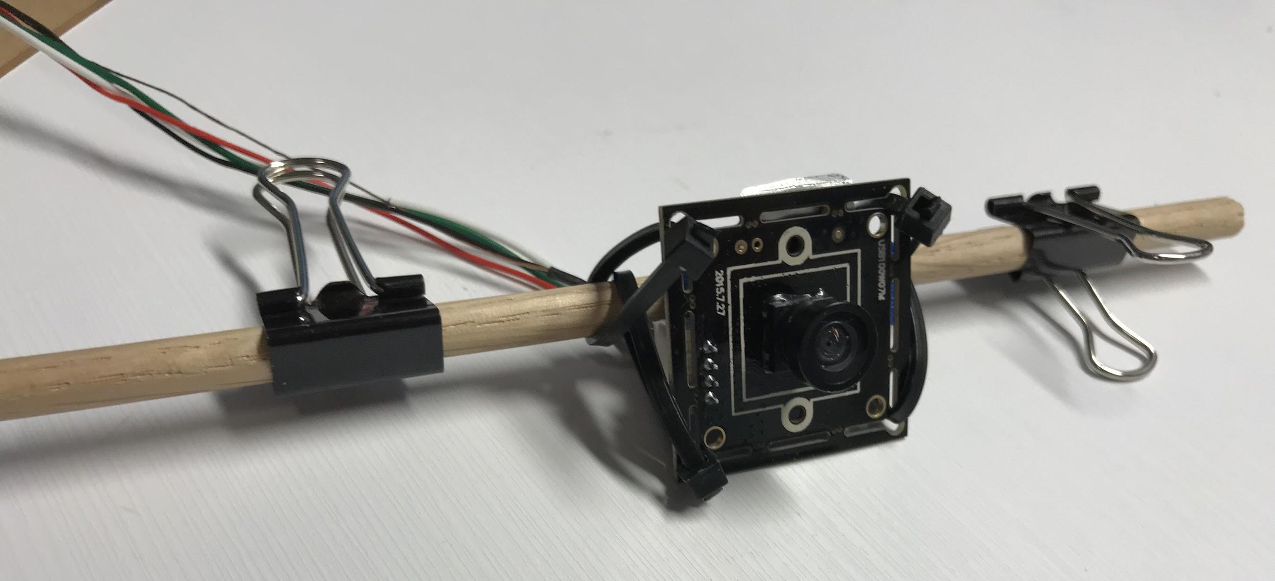
ExtraSlide: Hardware
Huge mess LMAO

